Slide 1
ECE 3130 – Digital Electronics and Design
Lab 6
Latch and Flip-Flops
Fall 2016

Slide 2
What are latches and flip-flops?
Sequential circuits that store information (i.e. memory elements – output depends not only on present inputs but also previous inputs)
Latches – output responds to input immediately as long as the enable signal (high level or low level) is asserted
Flip flops – output responds only to the rising and falling edge of the enable signal

Slide 3
Today’s lab
Build and test the following latch and flip-flops:
D Latch
D Flip Flop
JK Flip Flop
T Flip Flop

Slide 4
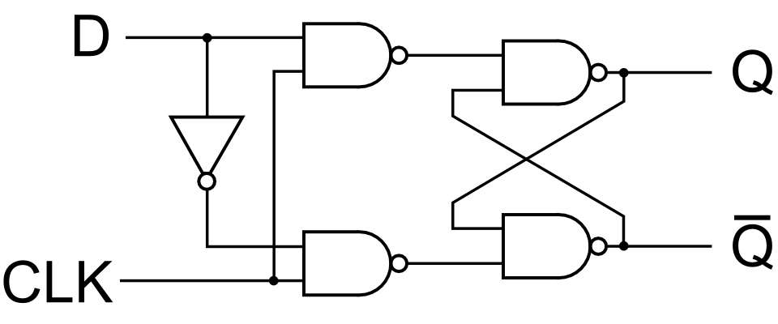
D Latch
Truth Table
Implementation
Clock | D | Q_{n} | Q_{n+1}
0 | X | 0 | 0
0 | X | 1 | 1
1 | 0 | X | 0(reset)
1 | 1 | X | 1(set)
The output Q follows D as long as the Clock signal is 1(high level).
Otherwise, it holds its value.
The output Q_bar is always inverted value of Q.

Slide 5
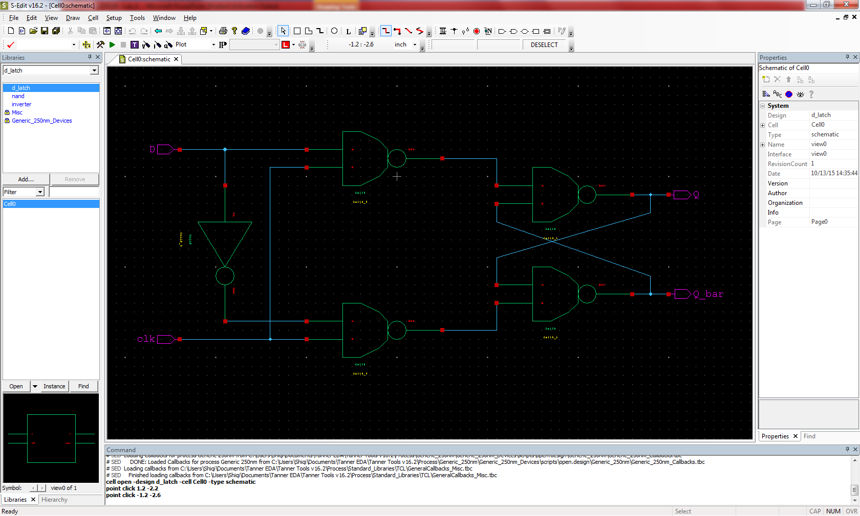
D-Latch - schematic

Slide 6

D-Latch - symbol

Slide 7
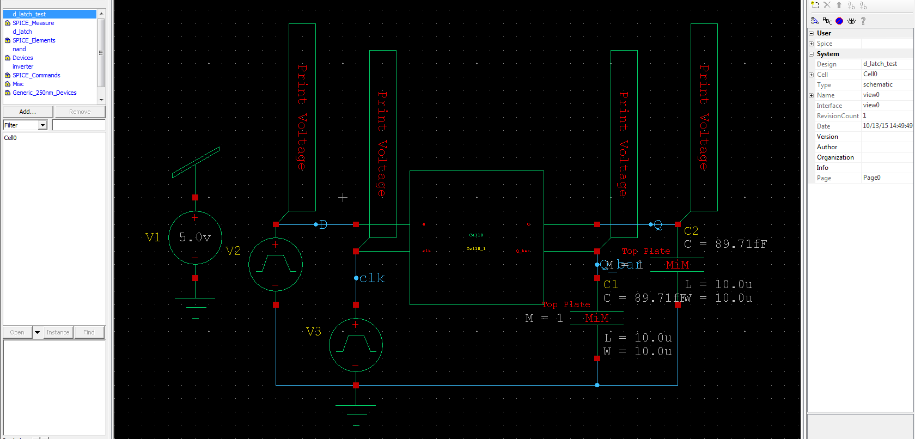
D-Latch - test circuit
Period time: Clk-150ns D-40ns
Fall/Rise time for all inputs: 1ns

Slide 8
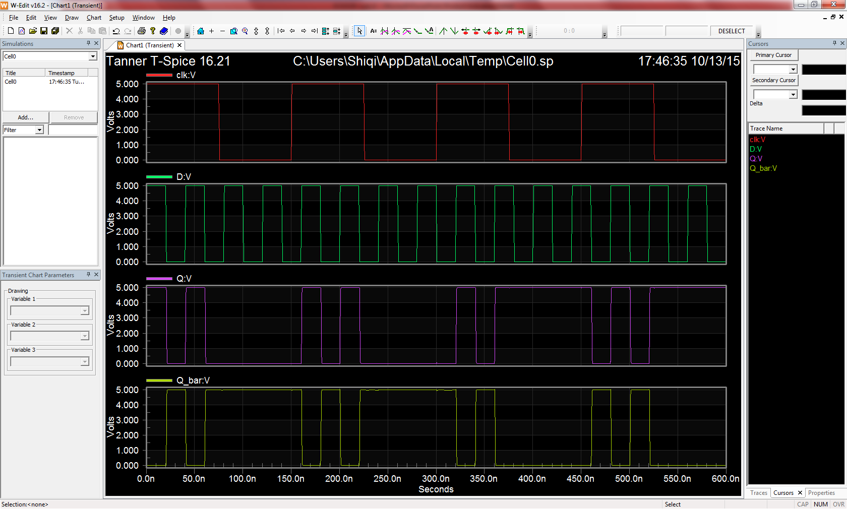
D-Latch - waveforms

Slide 9
D Flip-Flop (DFF)
The value of input D is stored on either the rising or falling clock edge.
The figure below shows a positive-edge triggered DFF.
Clock
D
Q

Slide 10
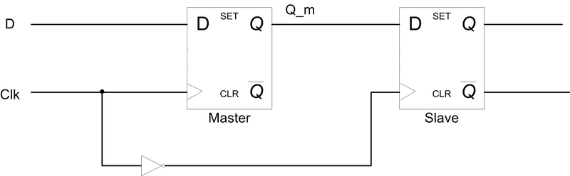
Master-Slave DFF
D Latch
D Latch
The “slave” DFF only changes when the “master” DFF changes.
The “slave” DFF clock is inverted, hence, this is negative-edge triggered.
For positive-edge triggering, switch the clock inputs between the “master” and the “slave”.

Slide 11
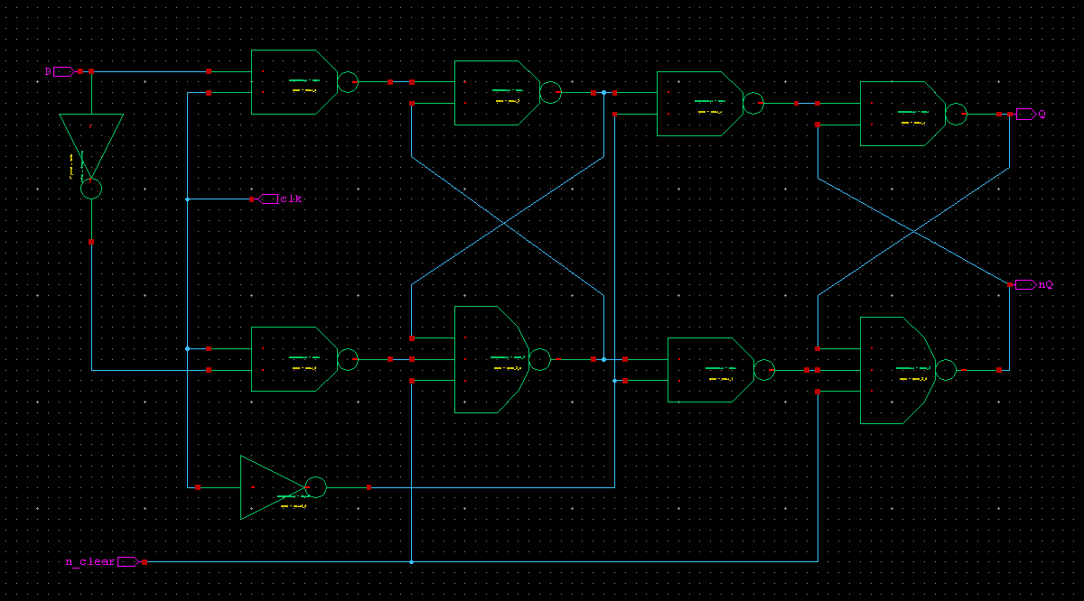
Master-Slave DFF with added clear pin (negative-edge triggered)
3-input NAND

Slide 12
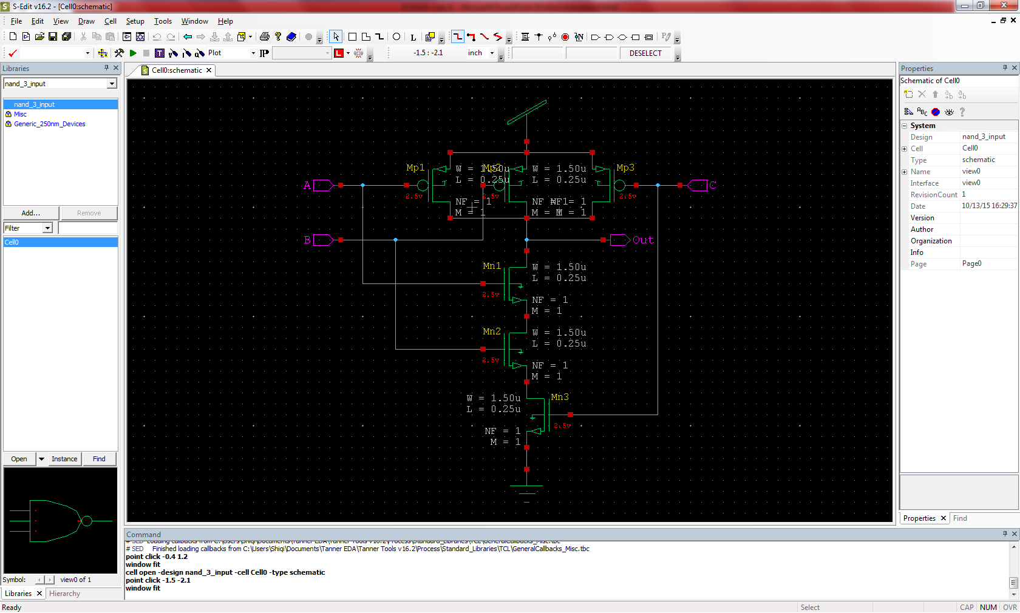
3-input NAND - schematic

Slide 13
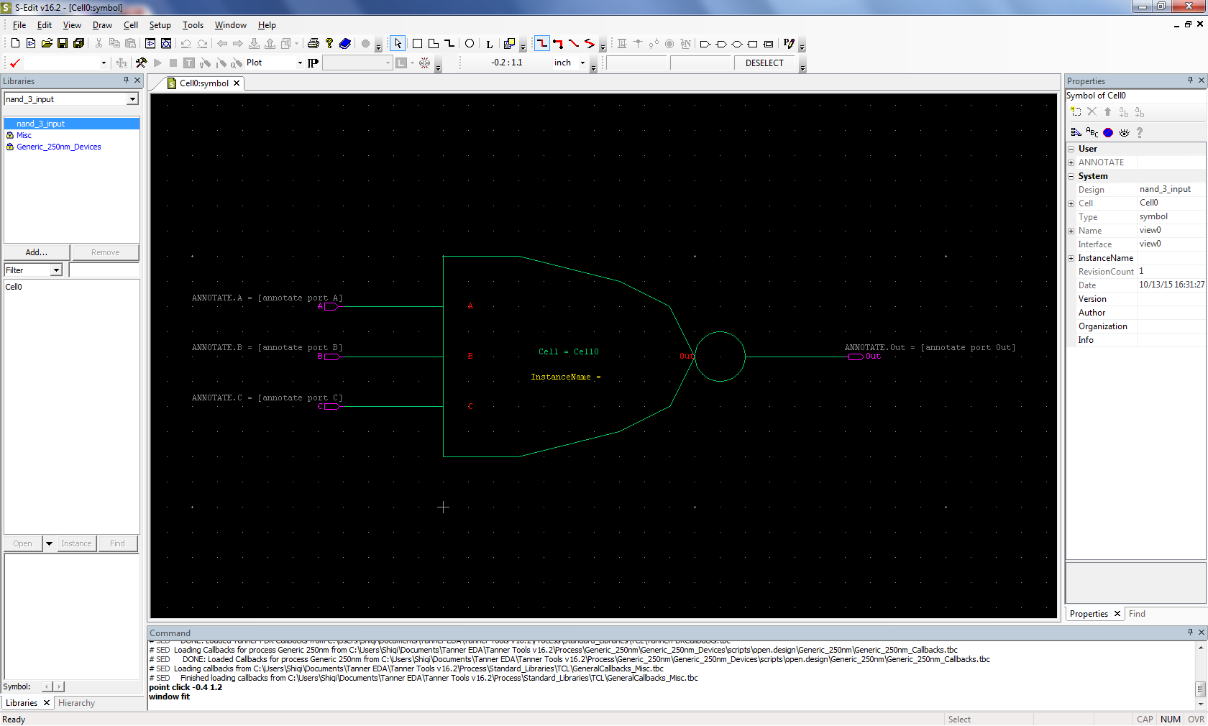
3-input NAND - symbol

Slide 14
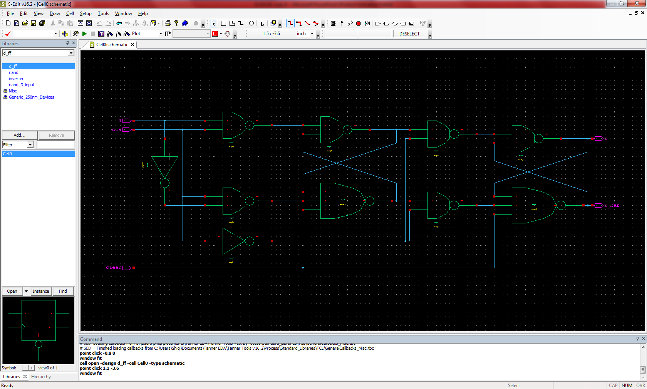
D-Flip Flop with clear pin - schematic

Slide 15
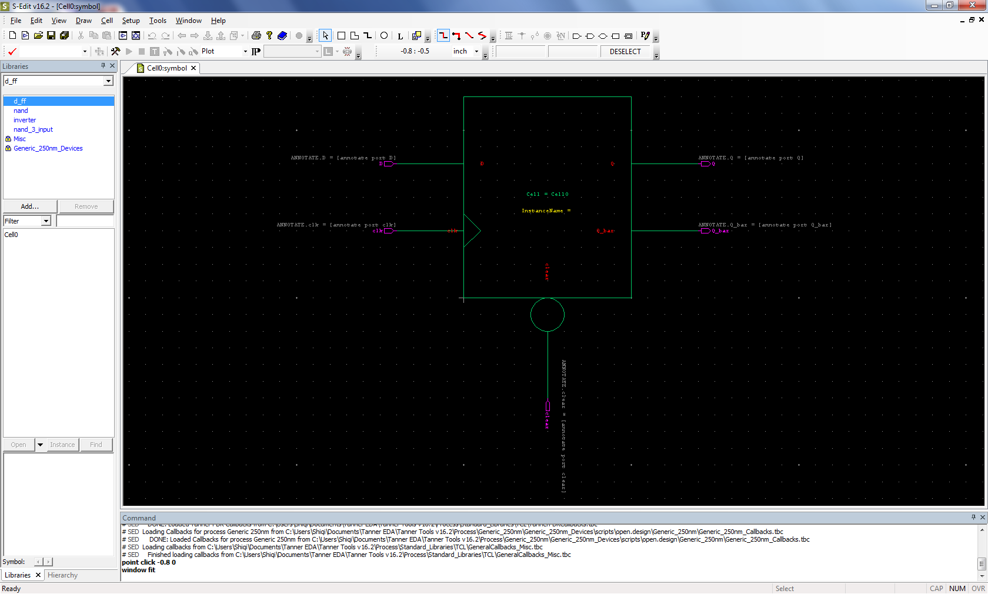
D-Flip Flop with clear pin - symbol

Slide 16
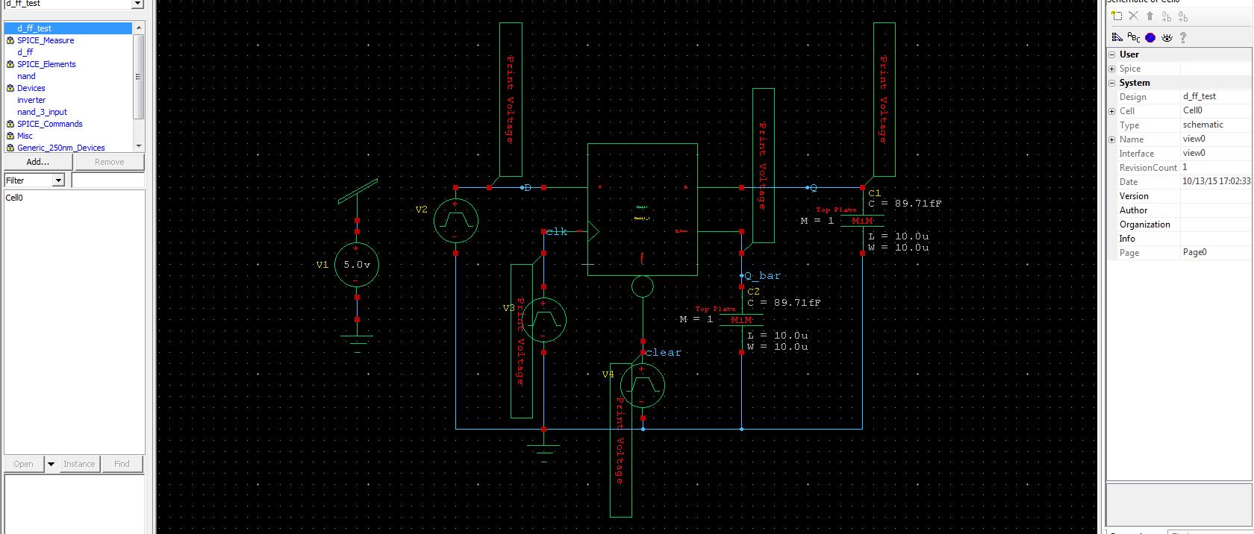
D-Flip Flop - test circuit
Period time: Clk-90ns D-40ns clear-600ns
Fall/Rise time for all inputs: 1ns

Slide 17
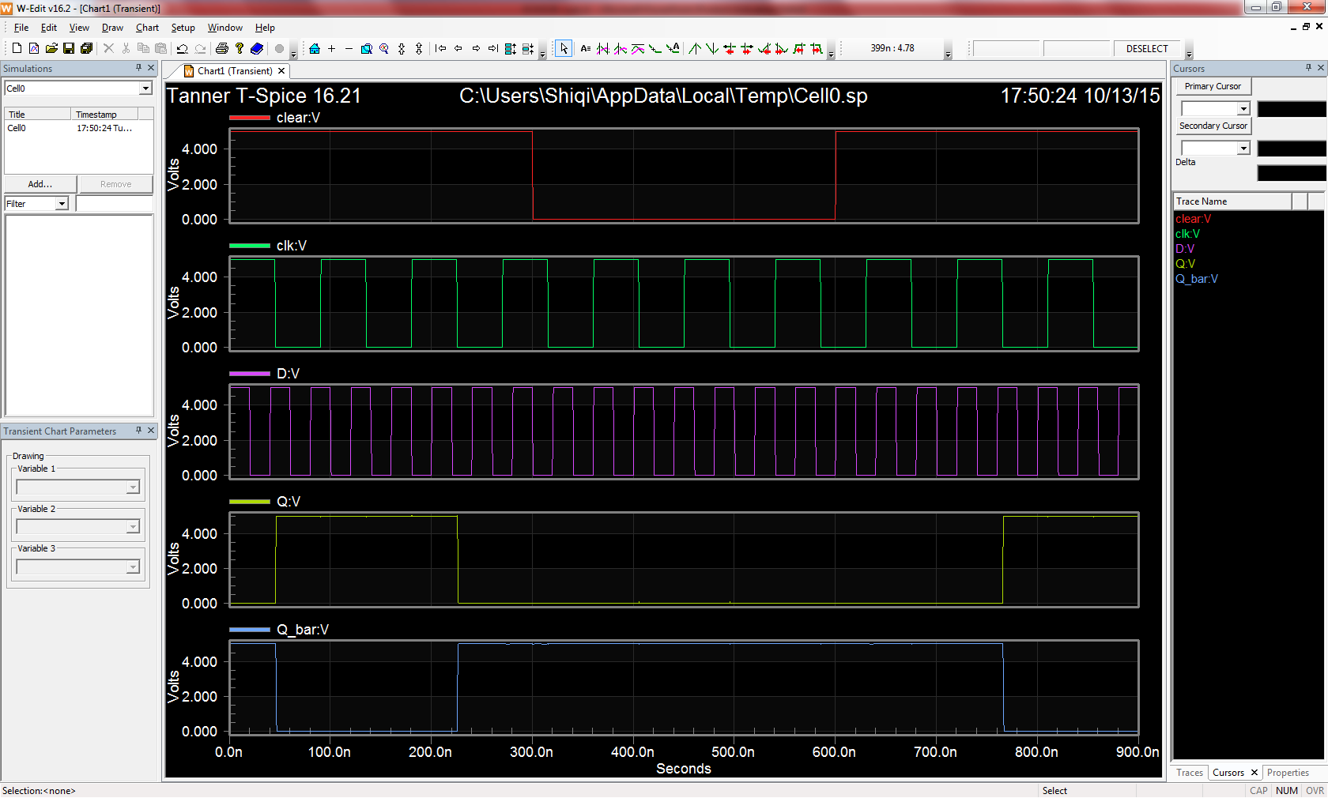
D-Flip Flop - waveforms

Slide 18
JK Flip-Flop
A universal flip-flop – can be configured as a SRFF, DFF, or TFF .
Identical to an SR flip-flop except that S=R=1 is no longer undefined, but rather “toggle/flip”.
J/S | K/R | Qnext
0 | 0 | Q (hold)
0 | 1 | 0
1 | 0 | 1
1 | 1 | nQ

Slide 19
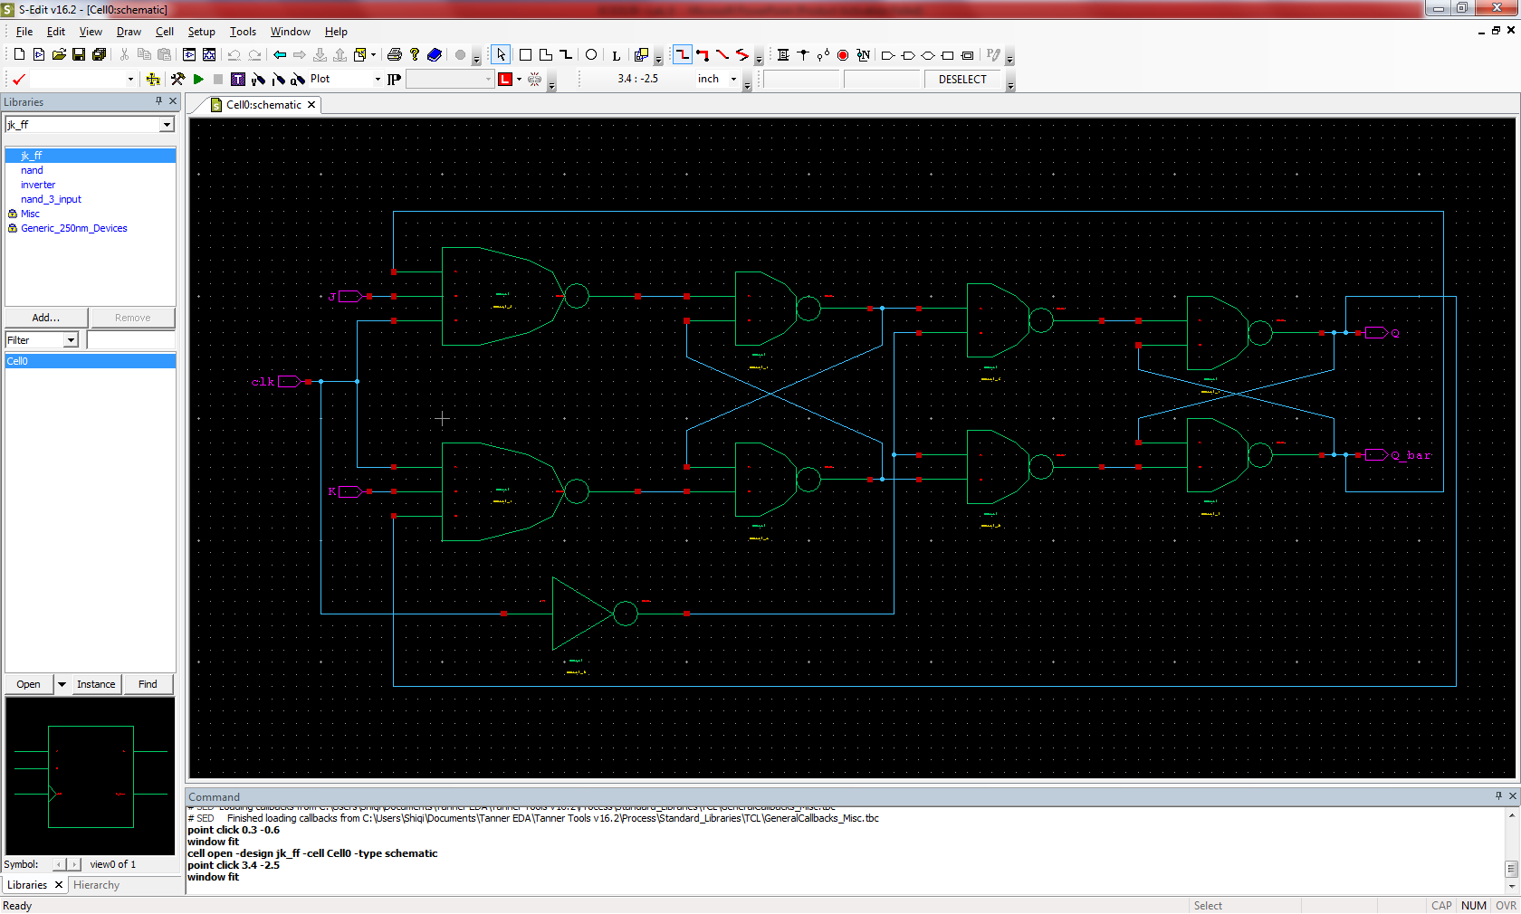
JK-Flip Flop - schematic

Slide 20
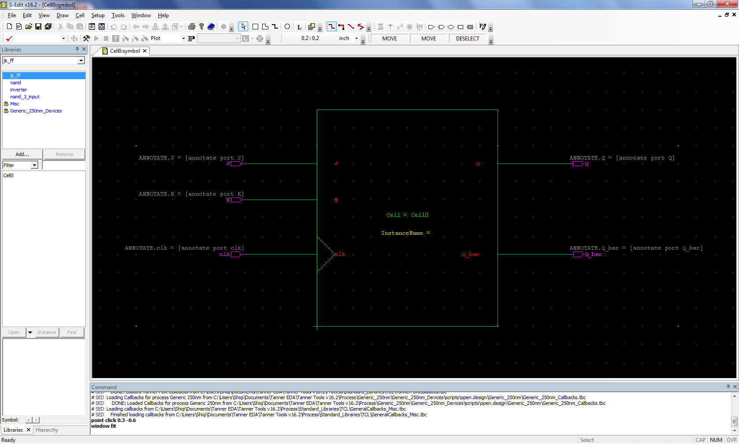
JK-Flip Flop - symbol

Slide 21
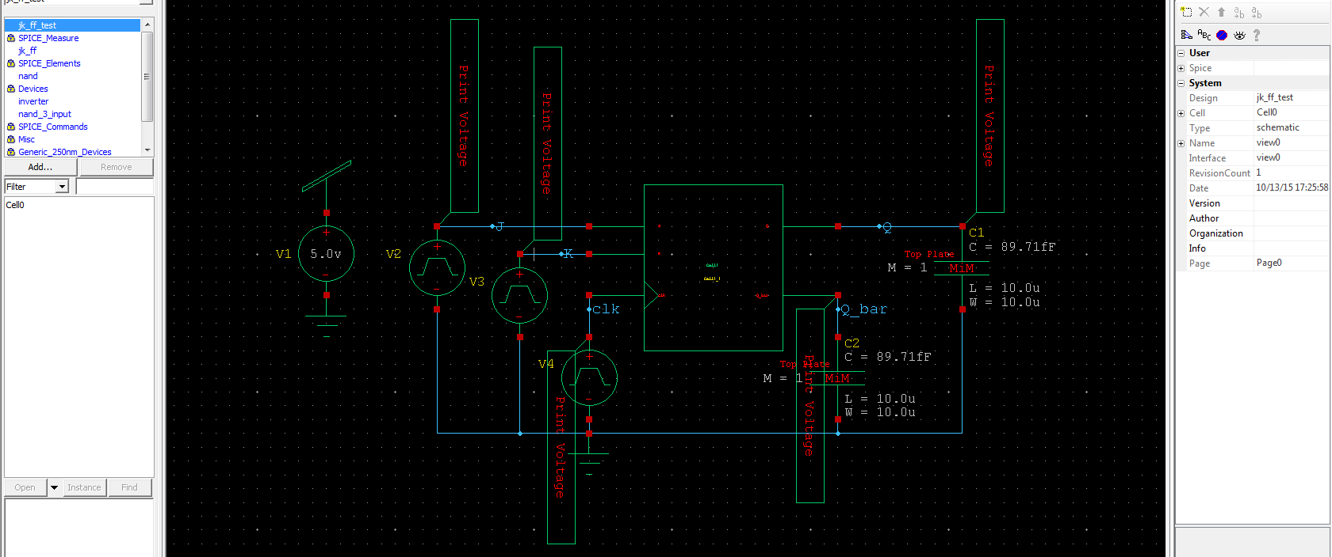
JK-Flip Flop - test circuit
Period time: Clk-50ns J-240ns K-200ns
Fall/Rise time for all inputs: 1ns

Slide 22
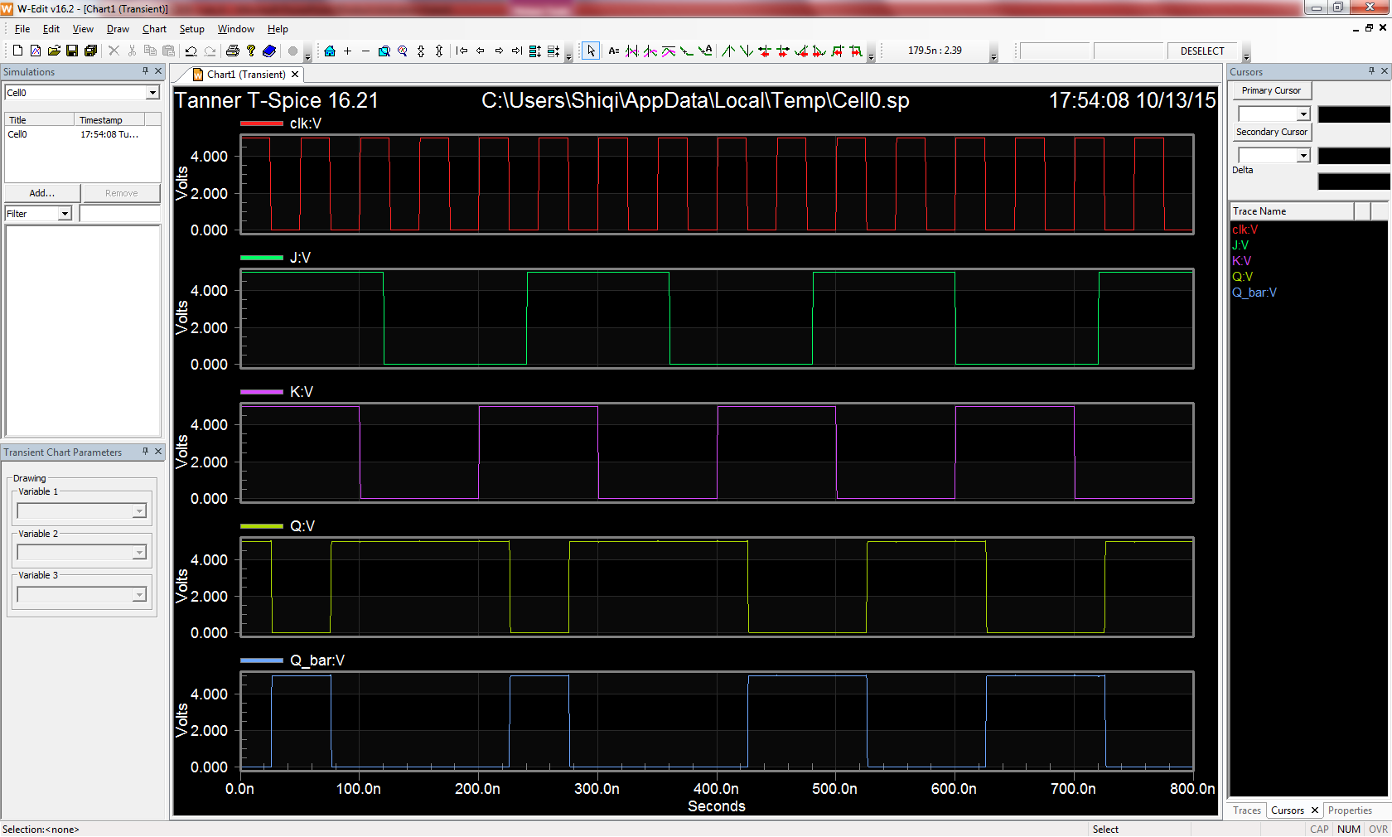
JK-Flip Flop - waveforms

Slide 23
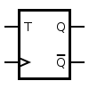
T Flip-Flop
Circuit Symbol
Truth Table
T | Q | Qnext
0 | 0 | 0
0 | 1 | 1
1 | 0 | 1
1 | 1 | 0
Tie the J and K inputs of the JK Flip-Flop to make a TFF.

Slide 24

T-Flip Flop - schematic
JK Flip-Flop

Slide 25
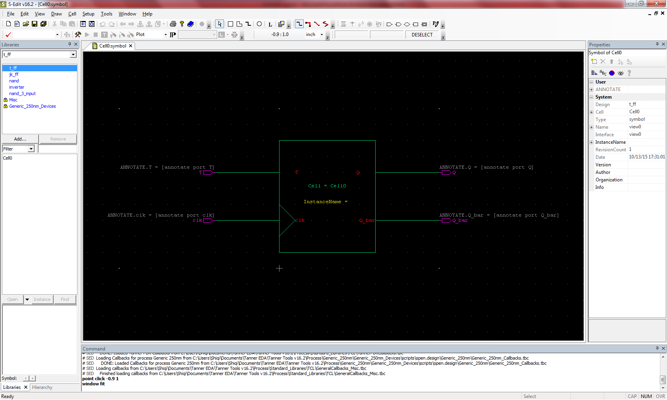
T-Flip Flop - symbol

Slide 26
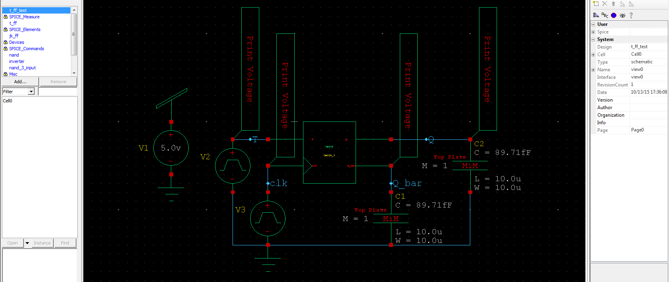
T-Flip Flop - test circuit
Period time: Clk-40ns T-155ns
Fall/Rise time for all inputs: 1ns

Slide 27
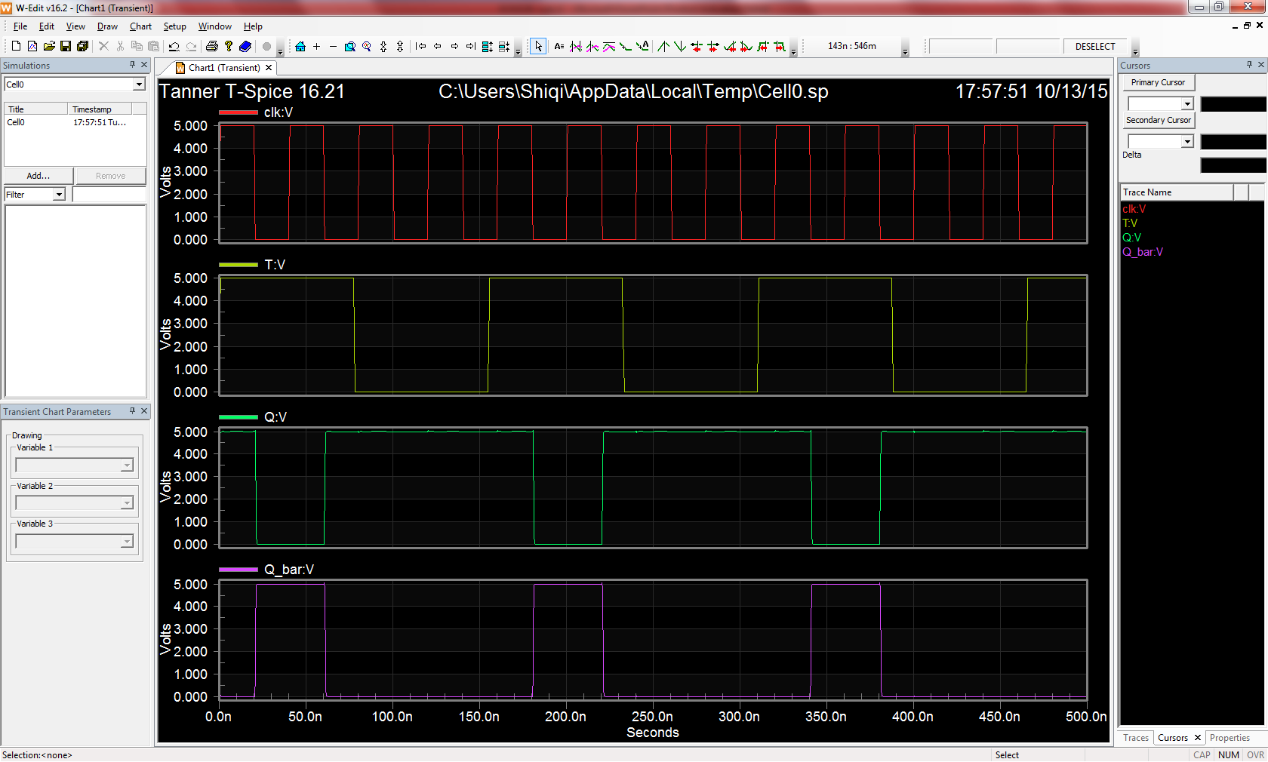
T-Flip Flop - waveforms

Slide 28
Assignment
Build and simulate a 3-input NAND Gate, a D-Latch, a D-FF with clear pin, a JK-FF and a T-FF.
Attach all screenshots into one PDF file, including schematic, symbol, test circuit schematic, and waveforms.

